Slide 1
Git for Windows
Windows

Slide 2

Download Git
Go to https://git-scm.com/downloads
Notes:
https://git-scm.com/downloads
1

Slide 3
Generate an SSH Key
2 options:
Git Bash
Git GUI

Slide 4
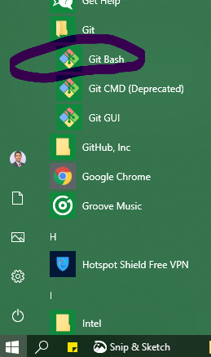
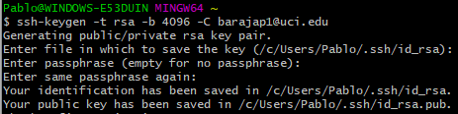
Git Bash
1- Open Git Bash
2- Paste the text below, substituting in your email address.
ssh-keygen -t rsa -b 4096 -C "your_email@example.com"
3- When you're prompted to "Enter a file in which to save the key," press Enter. This accepts the default file location.
Enter a file in which to save the key (/c/Users/you/.ssh/id_rsa):[Press enter]
4- At the prompt, type a secure passphrase.
Enter passphrase (empty for no passphrase): [Type a passphrase]
Enter same passphrase again: [Type passphrase again]
Notes:
https://help.github.com/en/articles/generating-a-new-ssh-key-and-adding-it-to-the-ssh-agent#generating-a-new-ssh-key
1

Slide 5
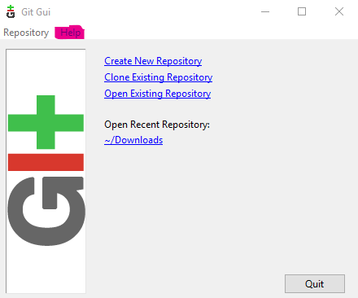
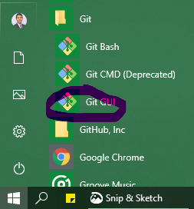
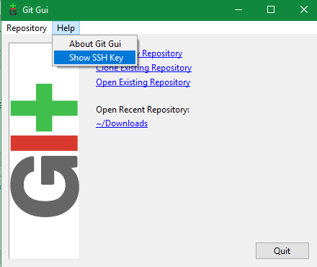
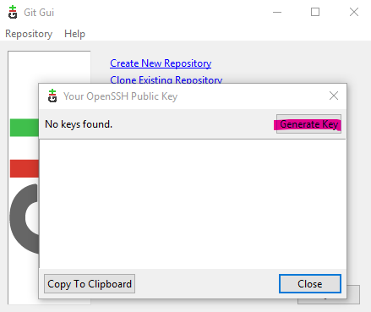
Git GUI
2- “Help” tab
1- Open Git GUI
3- Show SSH Key
4- Generate SSH Key

Slide 6
Extra
In git bash:
1. List all keys (Show the content of the .ssh folder in Git Bash)
ls -al ~/.ssh
2. Delete the id_rsa files (The Bash command for deleting files is rm –f)
rm -f ~/.ssh/id_rsa*
Notes:
<number>

